Slide 1

ASL INTERPRETING
GLOVE
FINAL
PRESENTATION
Team 7

Slide 2

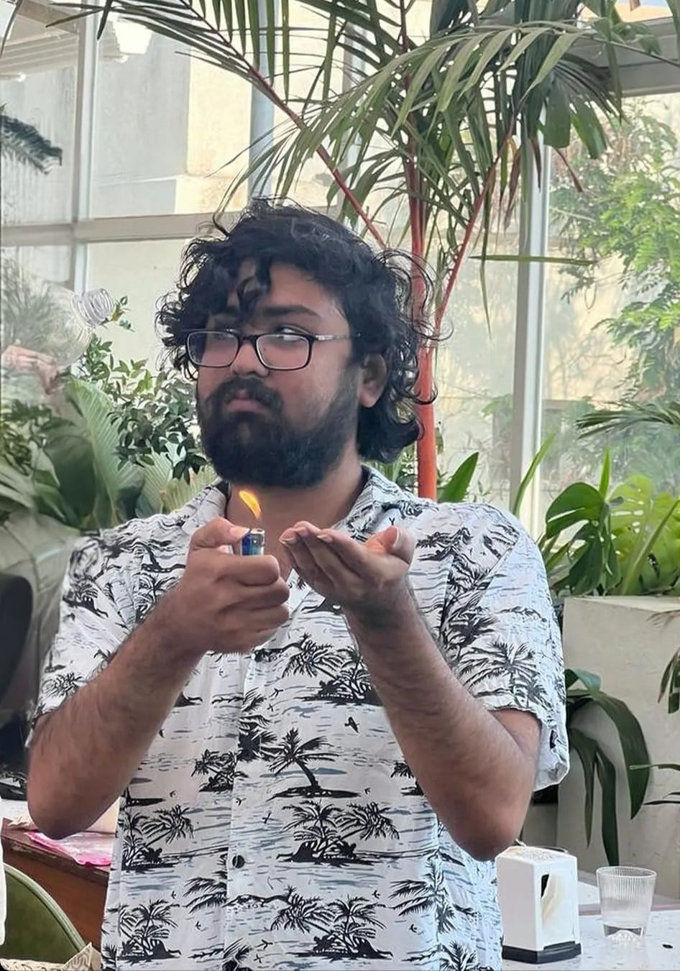
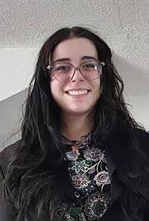
Team Members
Kris
Gurung
Anirudhhan
Raghuraman
Madalyn
Wiley

Slide 3
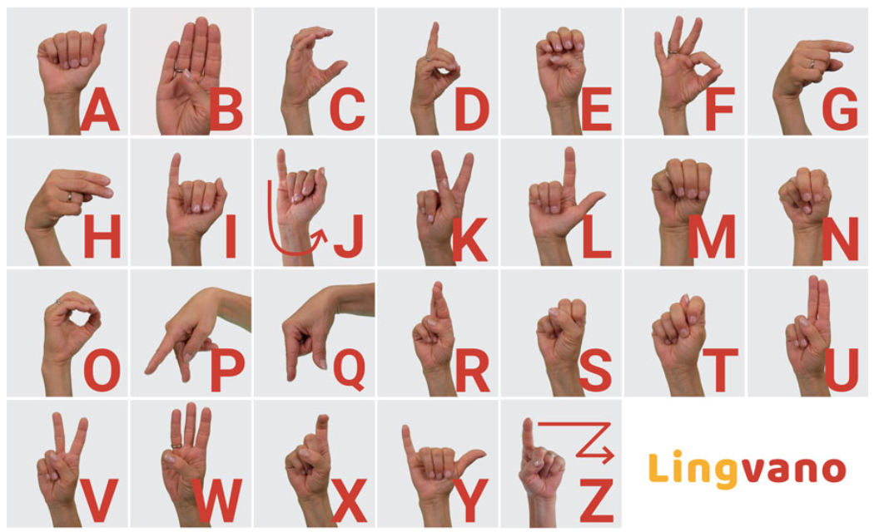
Project Summary
Design an American Sign Language (ASL)-interpreting glove that converts sign language to english and outputs the translation
ASL alphabet
Static signs
Synchronize 2 gloves
PCB for sleeker design
Future goals and works
Dynamic Signs
Fig 1: ASL alphabet [1]

Slide 4
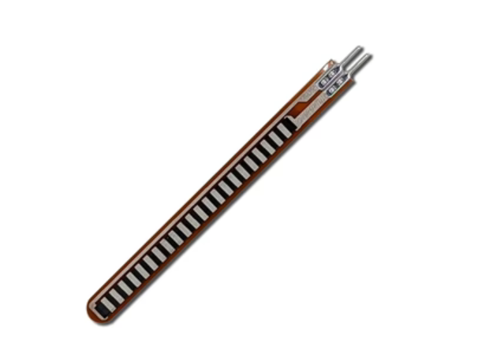
Project Challenges
The flex sensors were often unpredictable
Some pins were rendered unusable when the ESP32 was transmitting via WIFI connection
Struggles with a small dataset causing model inaccuracy
Fig. 2: Designed Printed Circuit Board

Slide 5
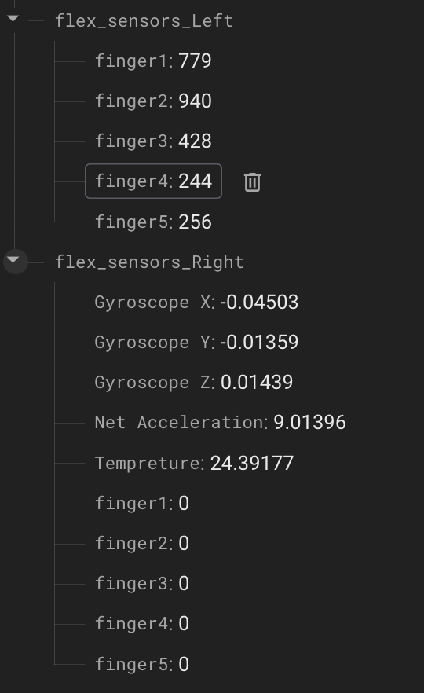

Pre-Midterm Progress
Circuit design completed
Able to read from the flex sensors
Flex sensor readings are sent to external firebase server
Machine Learning Model chosen and tested on similar datasets
Fig 3: Firebase Server
Fig 4: Old Web Server

Slide 6
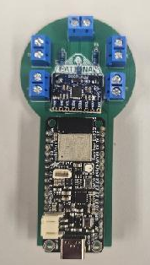
Post-Midterm Progress
Sign data collection
Model training + Inference
PCB Design
Configured Firebase for Inference display
Final Assembly and testing
Result analysis
Fig 5: PCB

Slide 7
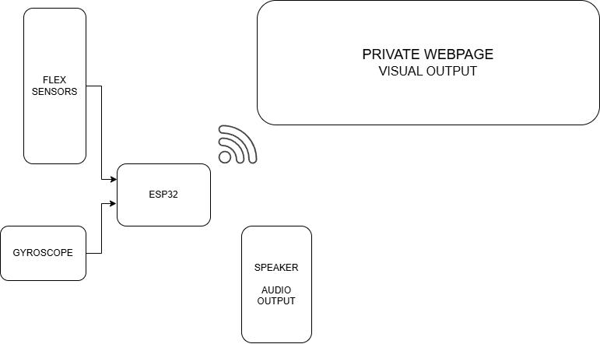
System Architecture
ESP32 collects readings
Sends to Firebase
ML model reads from Firebase and predicts the sign
Displayed on webpage
Fig 6: System Diagram

Slide 8
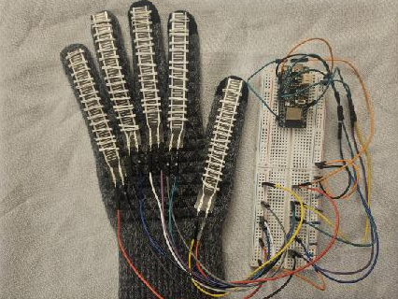
Approach - Hardware and Database
Five flex sensors attached to each finger of the glove.
One MPU6050 attached to ESP32 for accelerometer and gyroscope
Readings obtained through the use of 3.3 voltage source and 10K Ohm resistors to make a voltage divider with the flex sensors
Readings taken by the ESP32 connected to internet, then transmits to Firebase server.
Fig 7: Circuit

Slide 9

Approach - Machine Learning Model
Predictor model: Random Forest Decision Trees algorithm.
Good for non-linear data, and small datasets.
Implementation:
200 Decision Trees.
Each tree processes random data subset.
Makes Decision on hand-sign based on thresholds.
Final Decision: Majority Vote (of trees)
Fig. 7: Graphical representation of RFDT

Slide 10
Results
Sign | # of times attempted | # of times detected | % accuracy
ILY | 10 | 10 | 100
Point | 10 | 10 | 100
Fine | 10 | 9 | 90
A | 10 | 10 | 100
G | 10 | 9 | 90
O | 10 | 8 | 80
B | 10 | 10 | 100
F | 10 | 8 | 80
Y | 10 | 10 | 100
Average Accuracy | 90 | 84 | 93.33
Table 1: Results

Slide 11
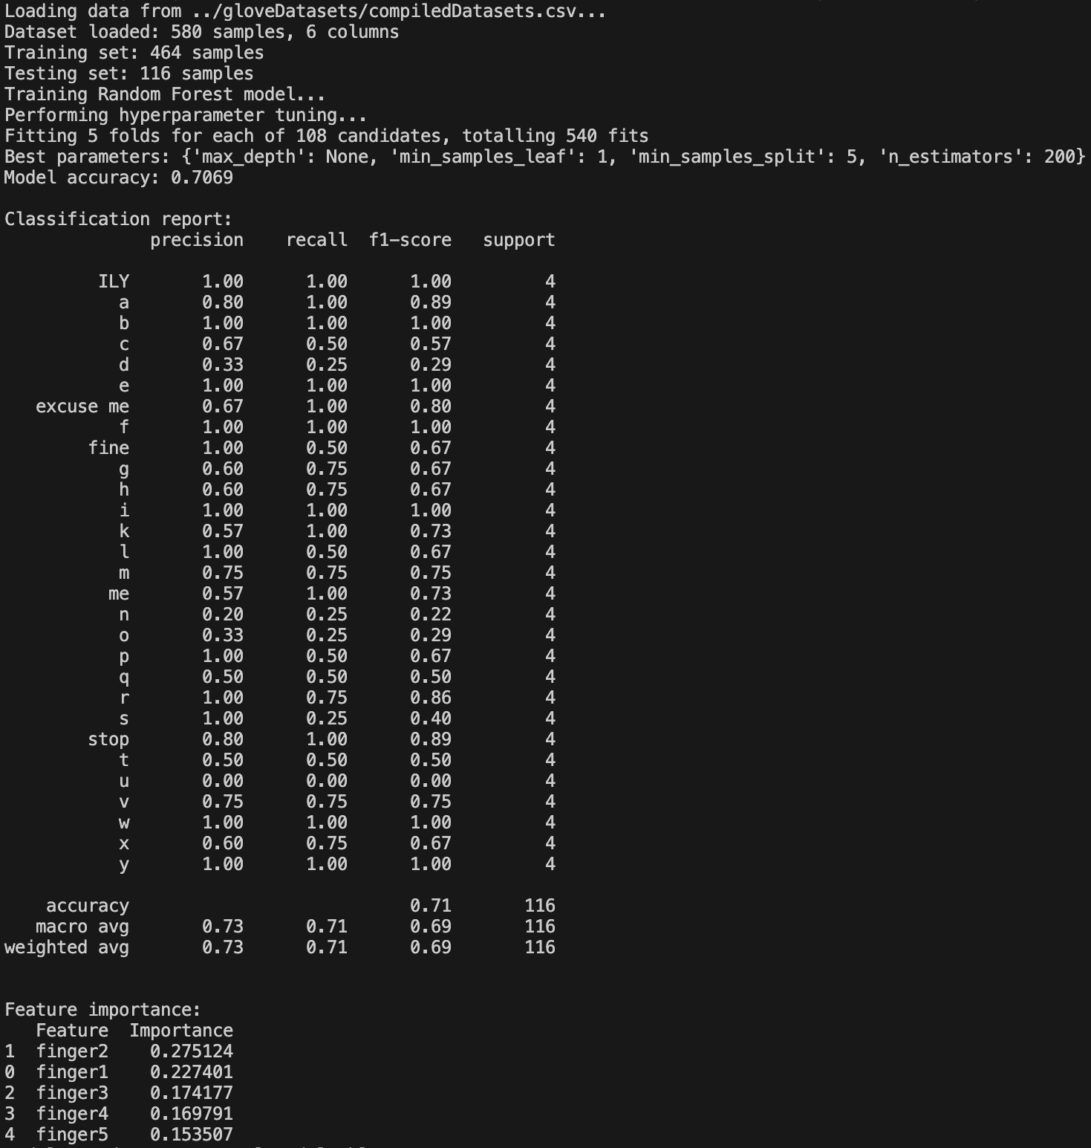
Results
Average Testing Accuracy: 70.69%
Metrics used:
Precision
Recall
F1-Score
Increased precision for inference
Hyperparameter Tuning: GridSearchCV
Fig 8: ML Model Results

Slide 12
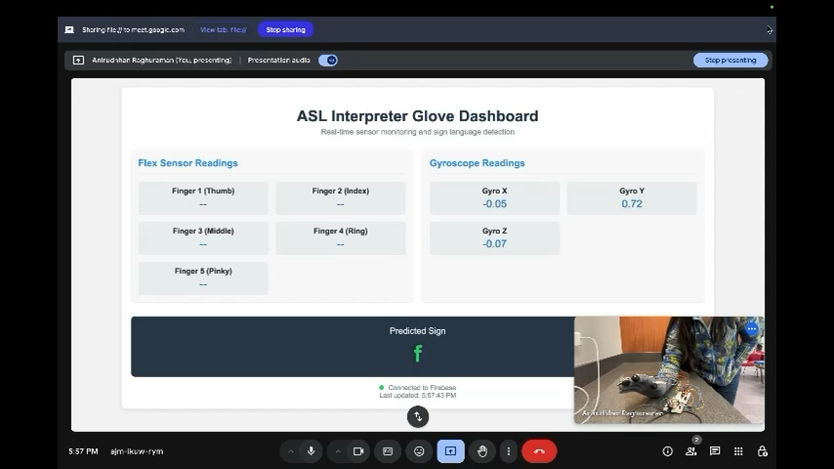
Demonstration

Slide 13
Future Plans
Redesign PCB to better suit the needs of the project
Select more accurate flex sensors
Implement lightweight ML Inference of ESP32
Enhance dataset for better model training
Continuously improve on the number of signs that can be translated

Slide 14
Sources
[1] “Sign Language Alphabet - Tips and Tricks to remember it fast!,” Lingvano ASL, Nov. 08, 2022. https://www.lingvano.com/asl/blog/sign-language-alphabet/

Slide 15
THANK YOU
Q/A

